Slide 1
Logistics Optimization for Delivery Routes – DHL
Course Project | SQL Analytics
By: Abhishek Chakraborty
Video Presentation Link: https://share.vidyard.com/watch/isjHU847RpZL7FdoPoVRMr

Slide 2
Project Overview
DHL operates a large global logistics network across air, ground, and last-mile delivery.
Increasing e-commerce demand has led to:
Delivery delays
Route congestion
Warehouse overload
This project uses SQL-driven analytics to identify operational bottlenecks and optimize delivery performance.

Slide 3
PROJECT OBJECTIVES
Identify delivery delay patterns
Analyze route and hub efficiency
Evaluate warehouse and delivery agent performance
Improve on-time delivery percentage
Provide data-driven business recommendations for DHL

Slide 4
DATASET OVERVIEW
Tables Used:
Orders – order and customer information
Shipments – pickup, delivery, delay, and tracking details
Routes – distance and expected transit times
Warehouses – capacity and location data
Delivery Agents – experience and performance metrics
Total Analysis Scope: End-to-end shipment lifecycle from order placement to delivery

Slide 5
DATA CLEANING & PREPARATION (TASK 1)
Could not find any duplicate Order_ID and Shipment_ID records
Could not find any missing delay values using route-level averages
Standardized all date columns into timestamp format
Flagged invalid records where delivery date < pickup date
Ensured referential integrity across all tables
Outcome: Clean and reliable dataset for accurate analysis

Slide 6
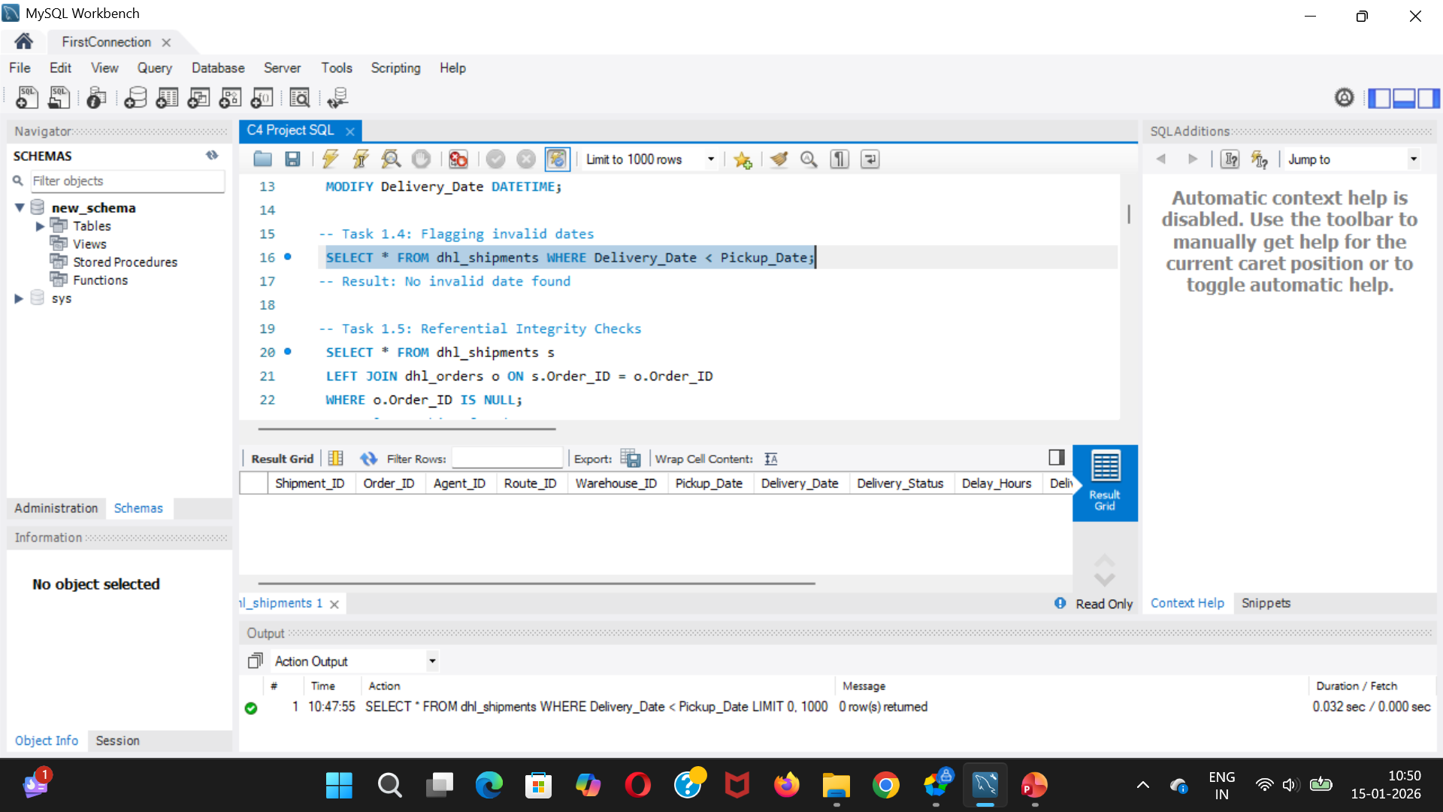
Task 1: Flagging dates where Delivery_Date occurs before Pickup_Date

Slide 7
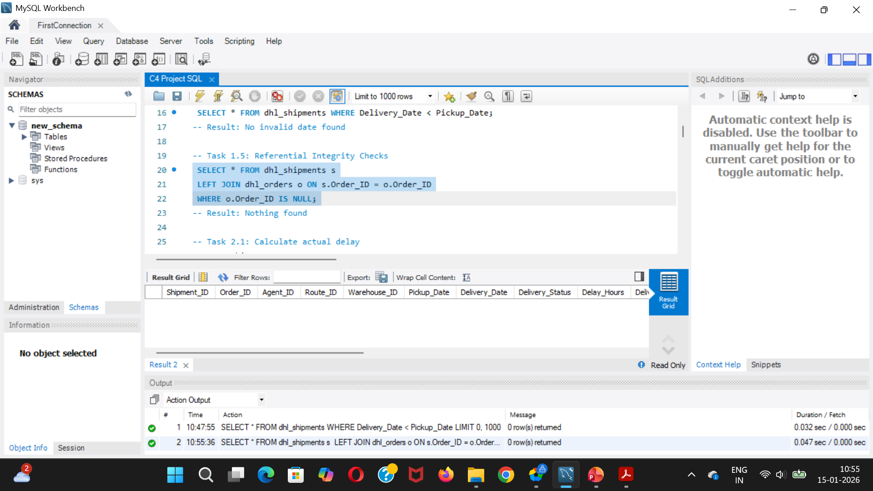
Task 1: Referential Integrity Validation

Slide 8
DELIVERY DELAY ANALYSIS (TASK 2)
Analysis Performed:
Calculated actual delivery delay using pickup and delivery timestamps
Identified Top 10 routes with highest average delays
Ranked delayed shipments within each warehouse
Compared delay performance between Express and Standard deliveries
Key Insight: Express deliveries generally outperform standard deliveries but still face route-based delays.

Slide 9
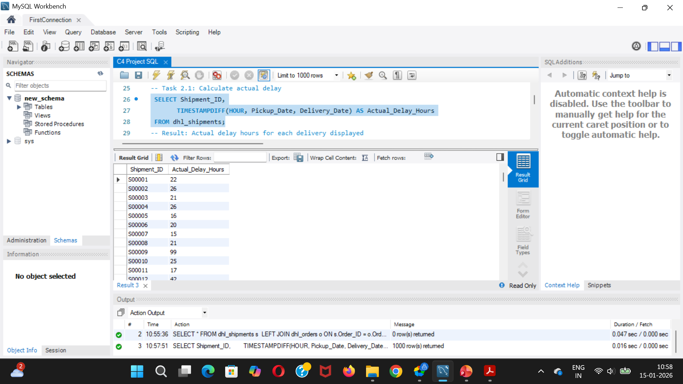
Task 2: Delivery delay calculation (in hours) for each shipment

Slide 10
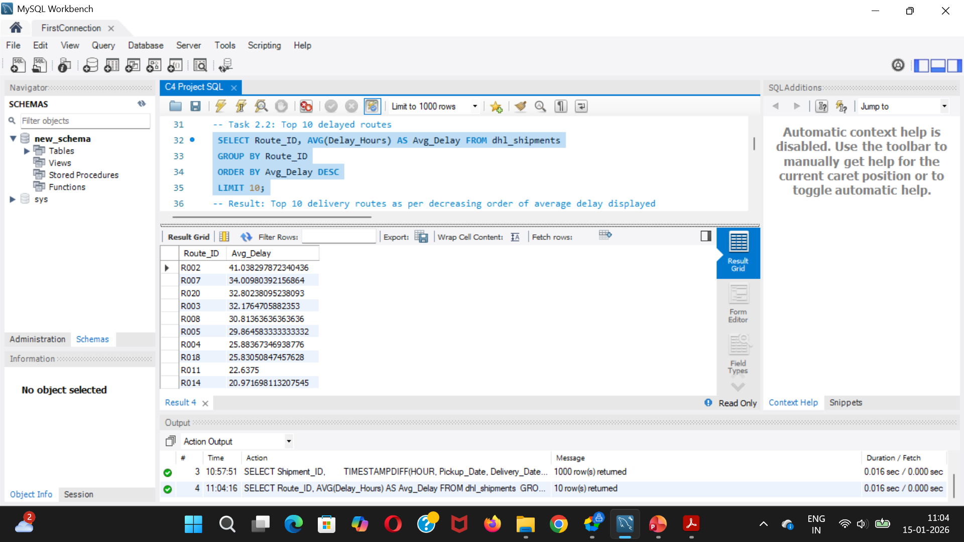
Task 2: Top 10 delayed routes based on average delay hours

Slide 11
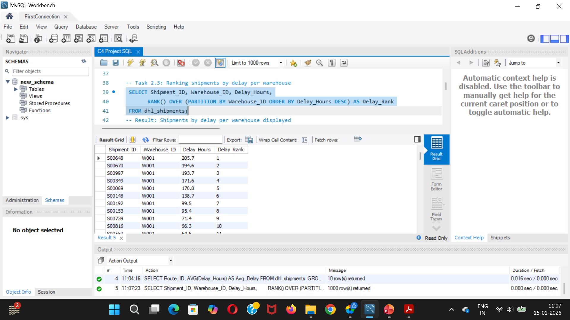
Task 2: Shipments by delay within each Warehouse_ID

Slide 12
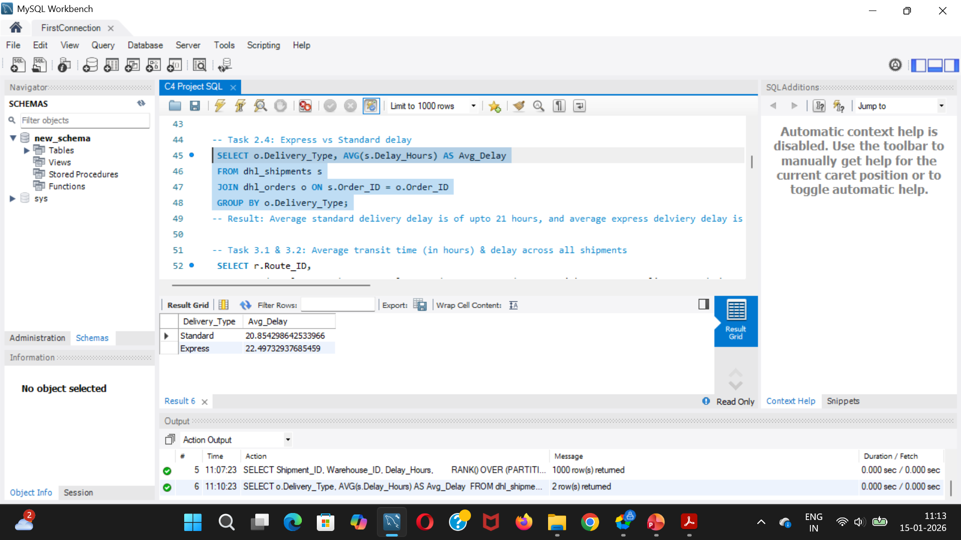
Task 2: Average delay per Delivery_Type (Express / Standard)

Slide 13
ROUTE OPTIMIZATION INSIGHTS (TASK 3)
Metrics Calculated:
Average transit time per route
Average delay per route
Distance-to-time efficiency ratio
Findings:
Some short-distance routes are less efficient than long-distance routes
Identified 3 routes with worst efficiency ratios
Several routes have more than 20% delayed shipments

Slide 14
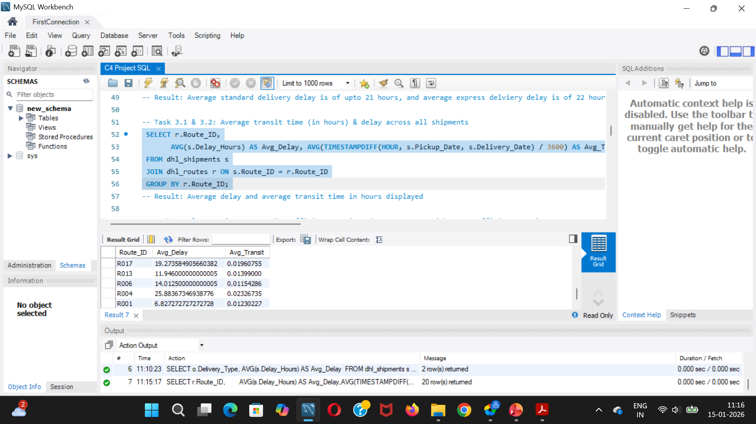
Task 3: Average transit time (in hours) and average delay (in hours) per route.

Slide 15
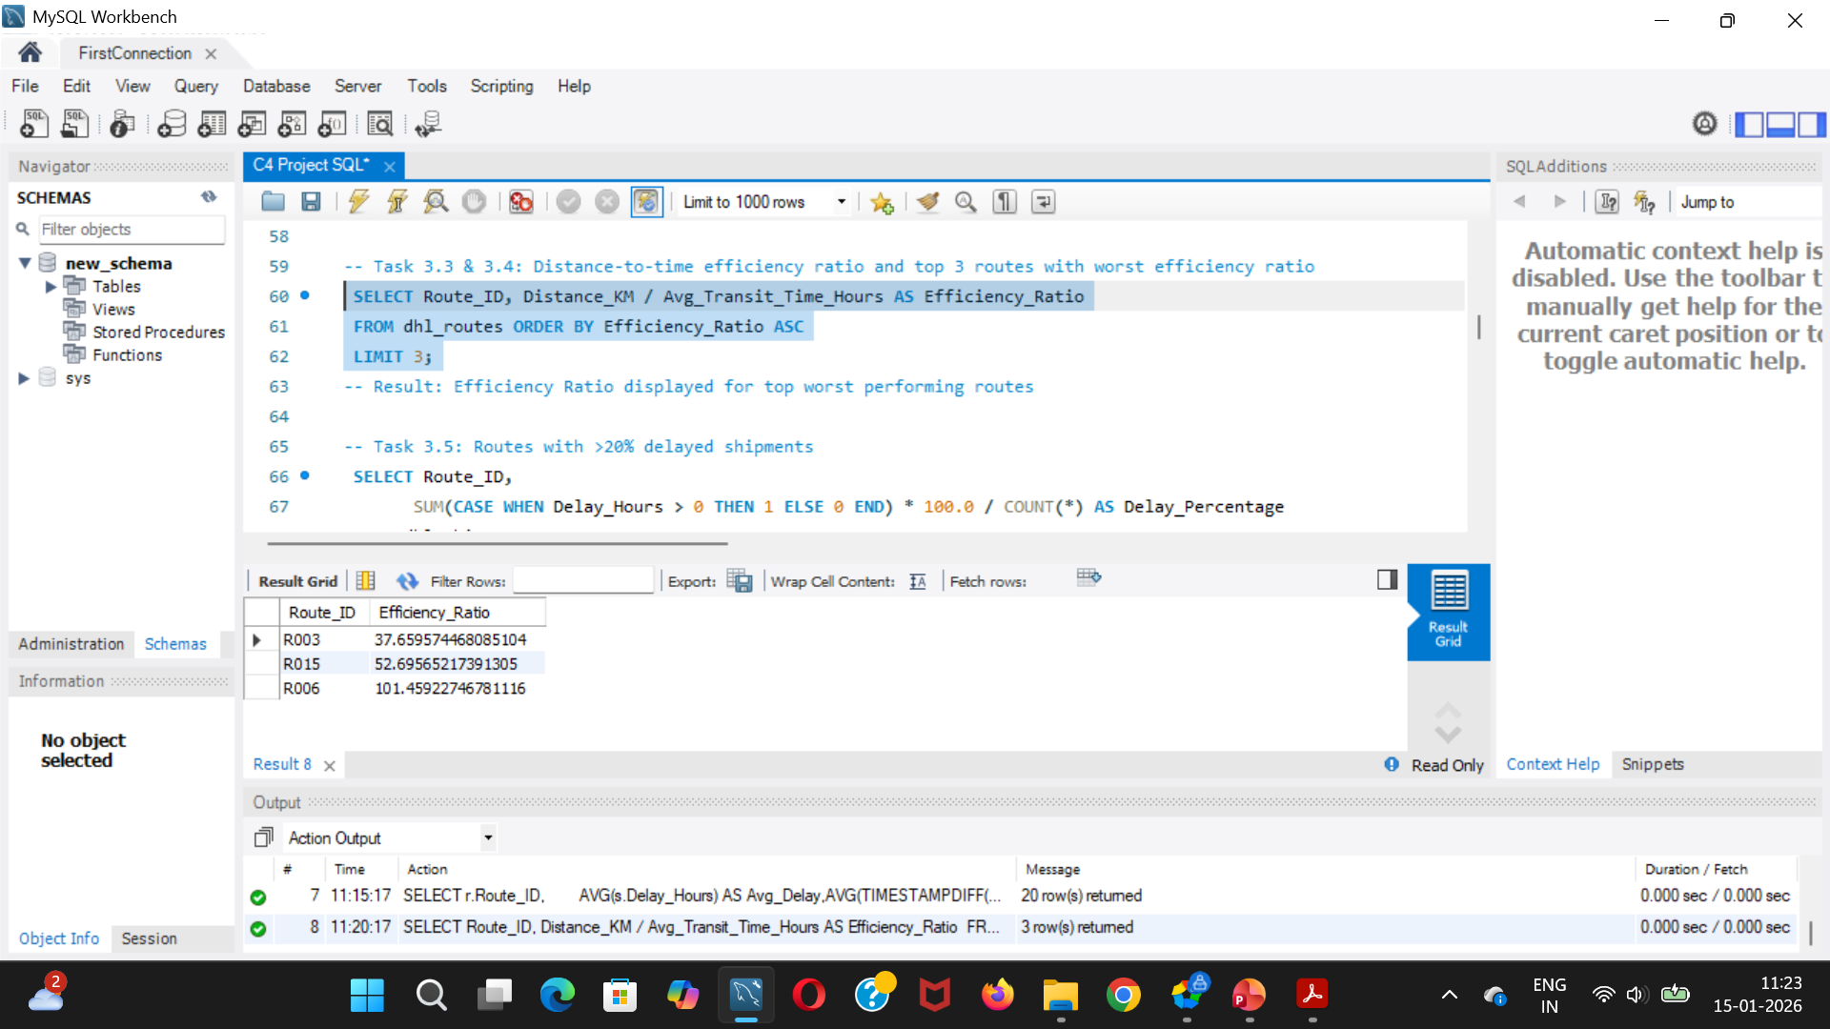
Task 3: Distance-to-time efficiency ratio = Distance_KM / Avg_Transit_Time_Hours and top 3 routes with the worst efficiency ratio

Slide 16
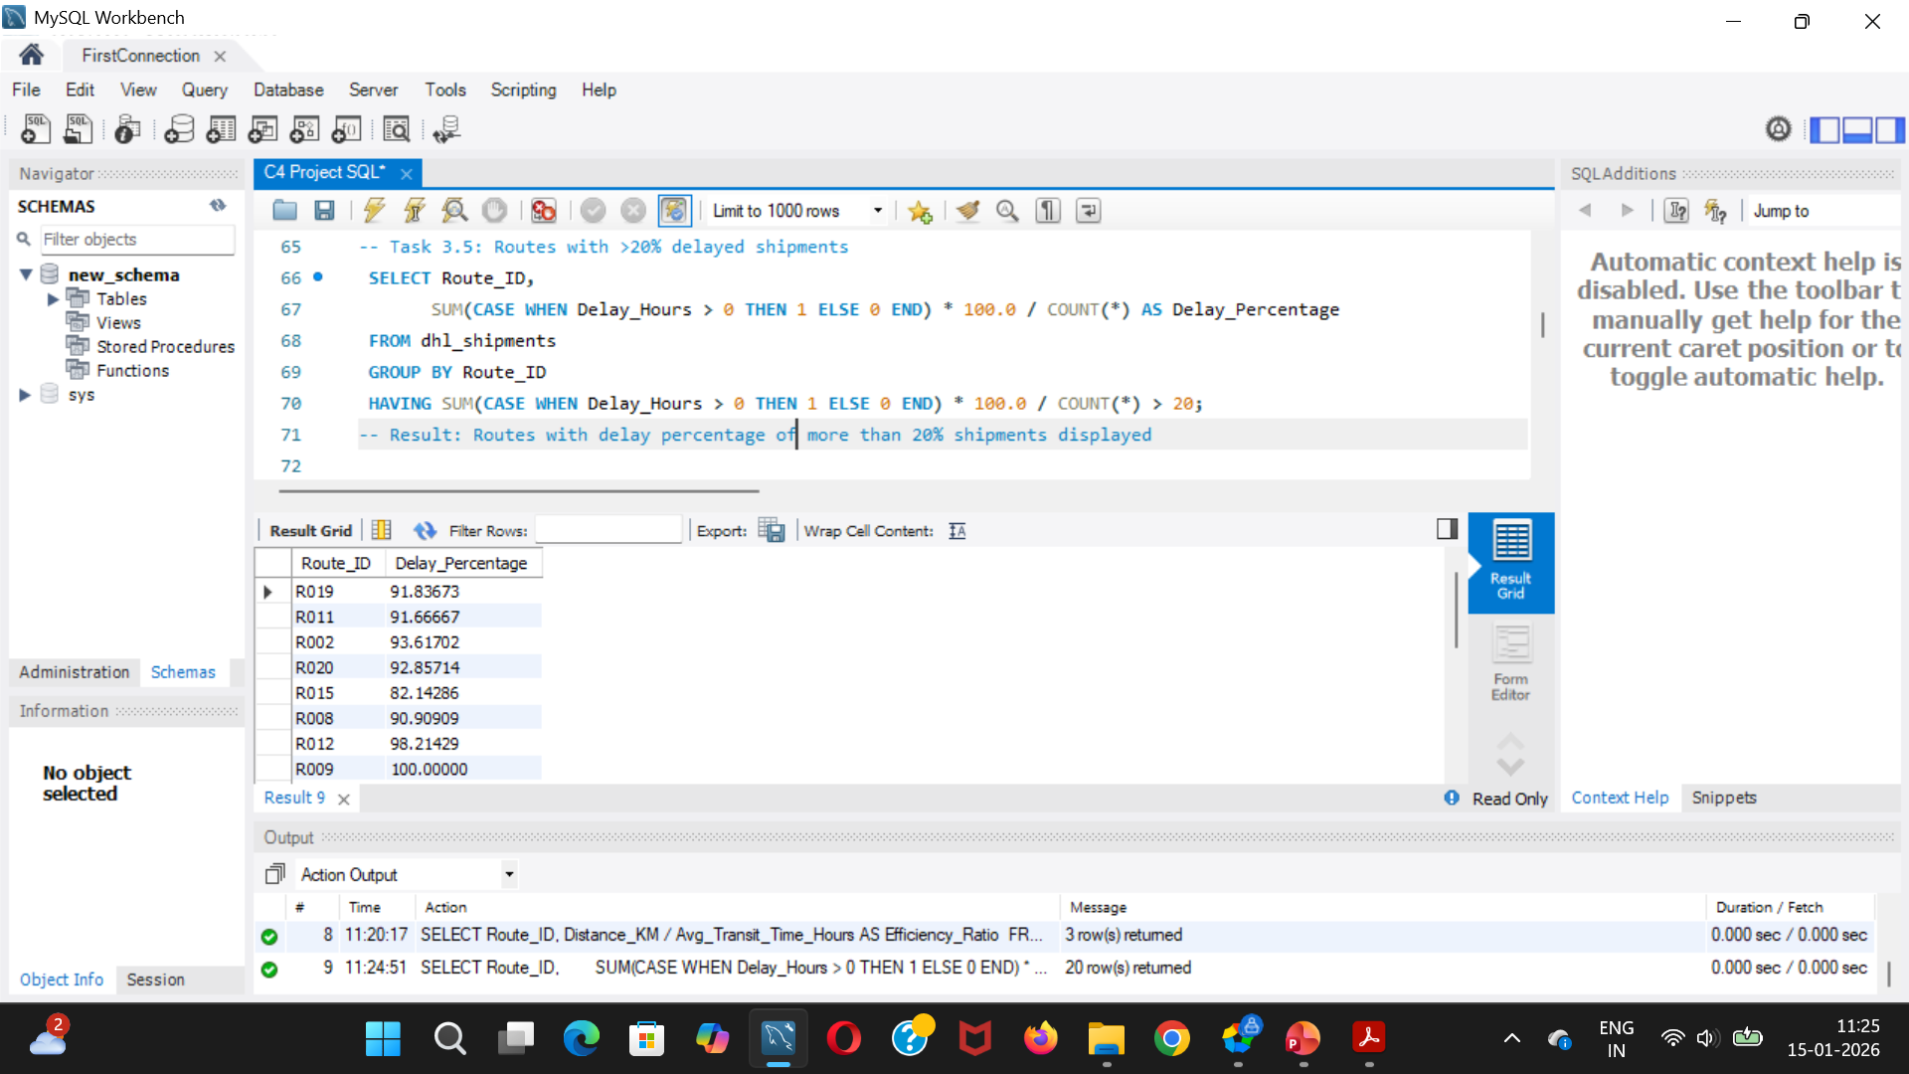
Task 3: Routes with >20% of shipments delayed

Slide 17
WAREHOUSE PERFORMANCE ANALYSIS (TASK 4)
Analysis Performed:
Identified top 3 warehouses with highest average delay
Compared total shipments vs delayed shipments
Flagged warehouses exceeding global average delay
Ranked warehouses by on-time delivery percentage
Key Insight: High warehouse utilization often correlates with increased delivery delays.

Slide 18
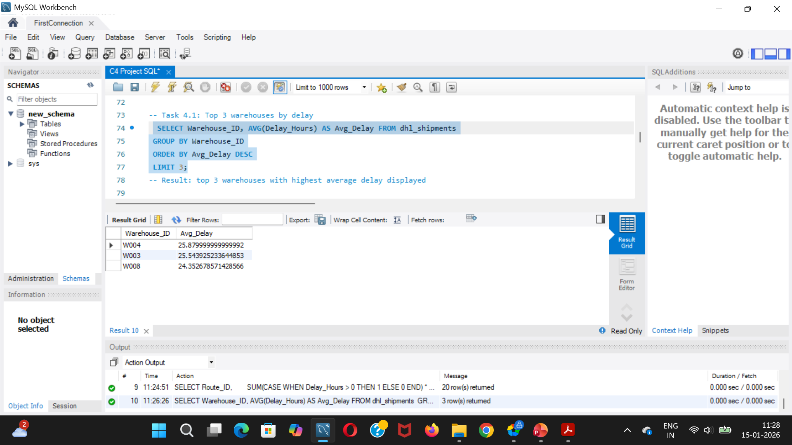
Task 4: Top 3 warehouses with the highest average shipment delay

Slide 19
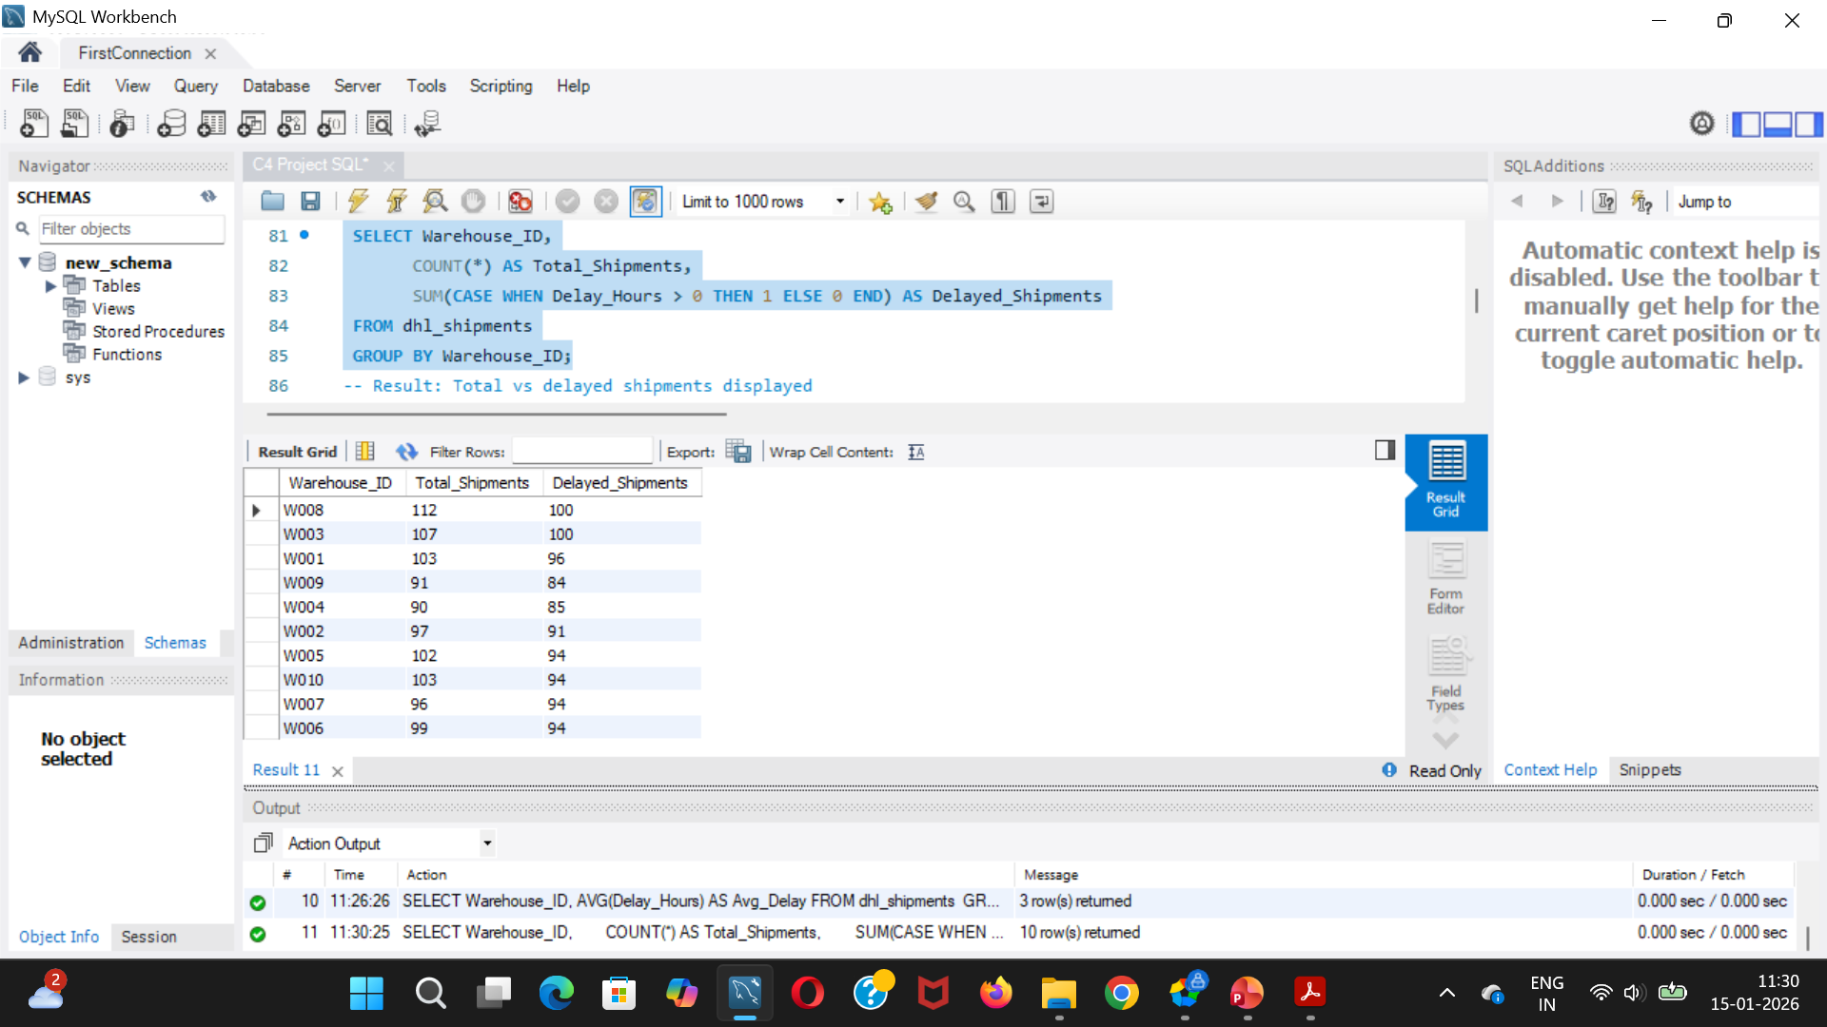
Task 4: total shipments vs delayed shipments for each warehouse

Slide 20
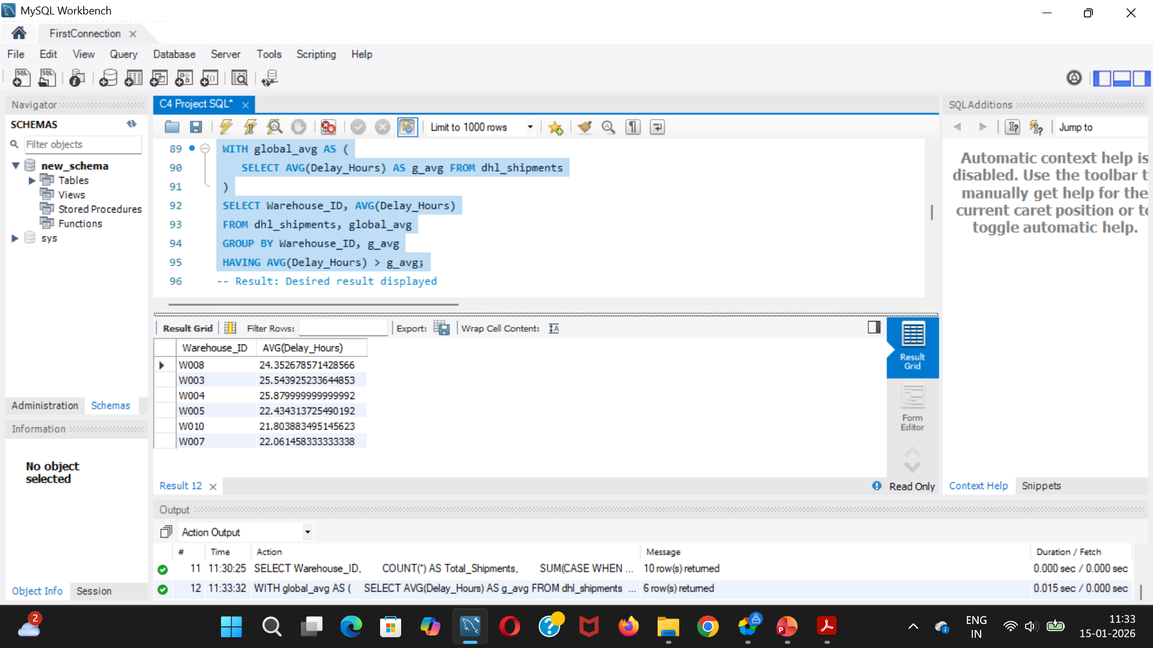
Task 4: Warehouses where average delay exceeds the global average delay

Slide 21
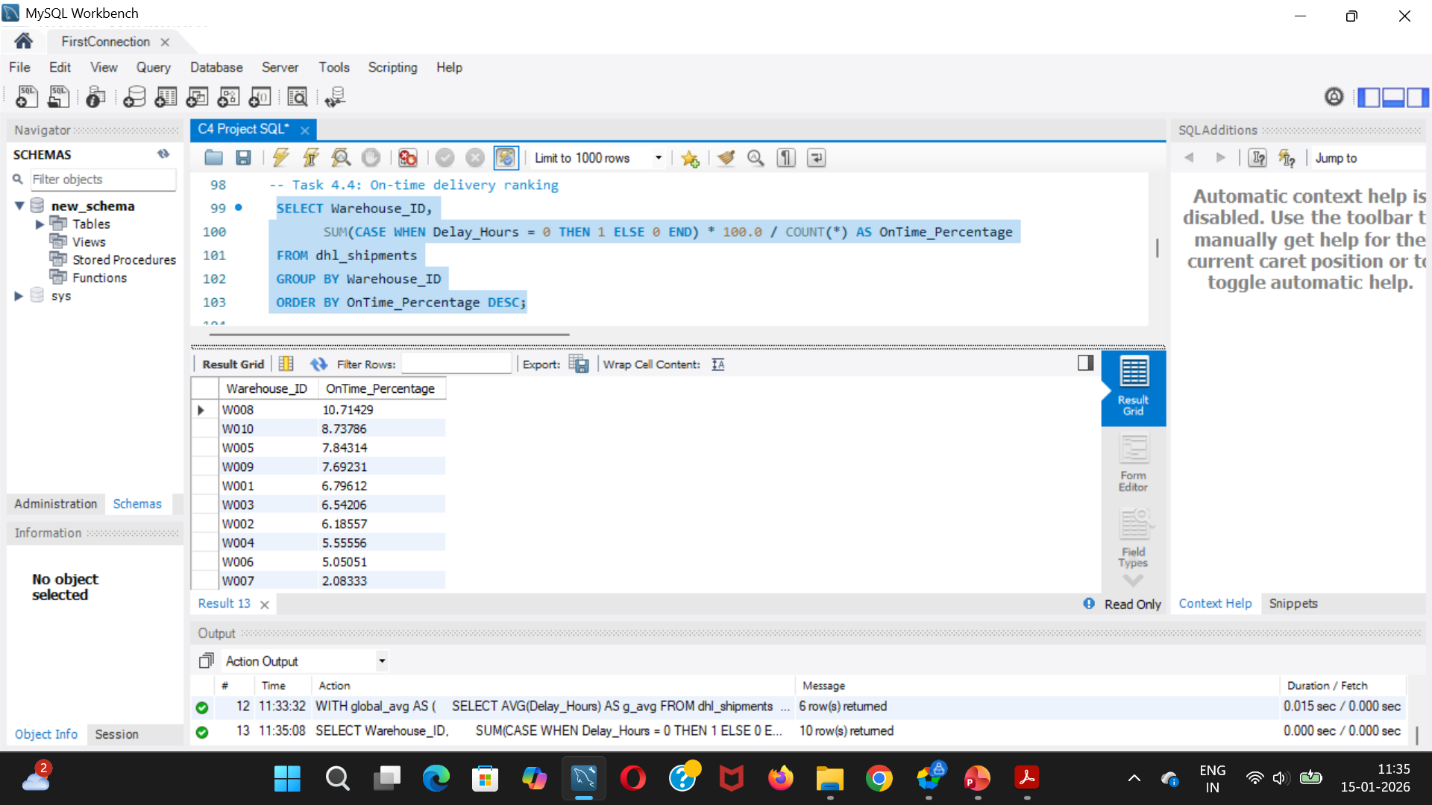
Task 4: Warehouse ranking based on delivery percentage

Slide 22
DELIVERY AGENT PERFORMANCE (TASK 5)
Metrics Used:
On-time delivery percentage per agent and route
Agent performance ranking
Experience and rating comparison
Findings:
Agents with higher experience show better on-time performance
Identified agents below 85% on-time threshold
Performance gaps suggest training and workload balancing needs

Slide 23
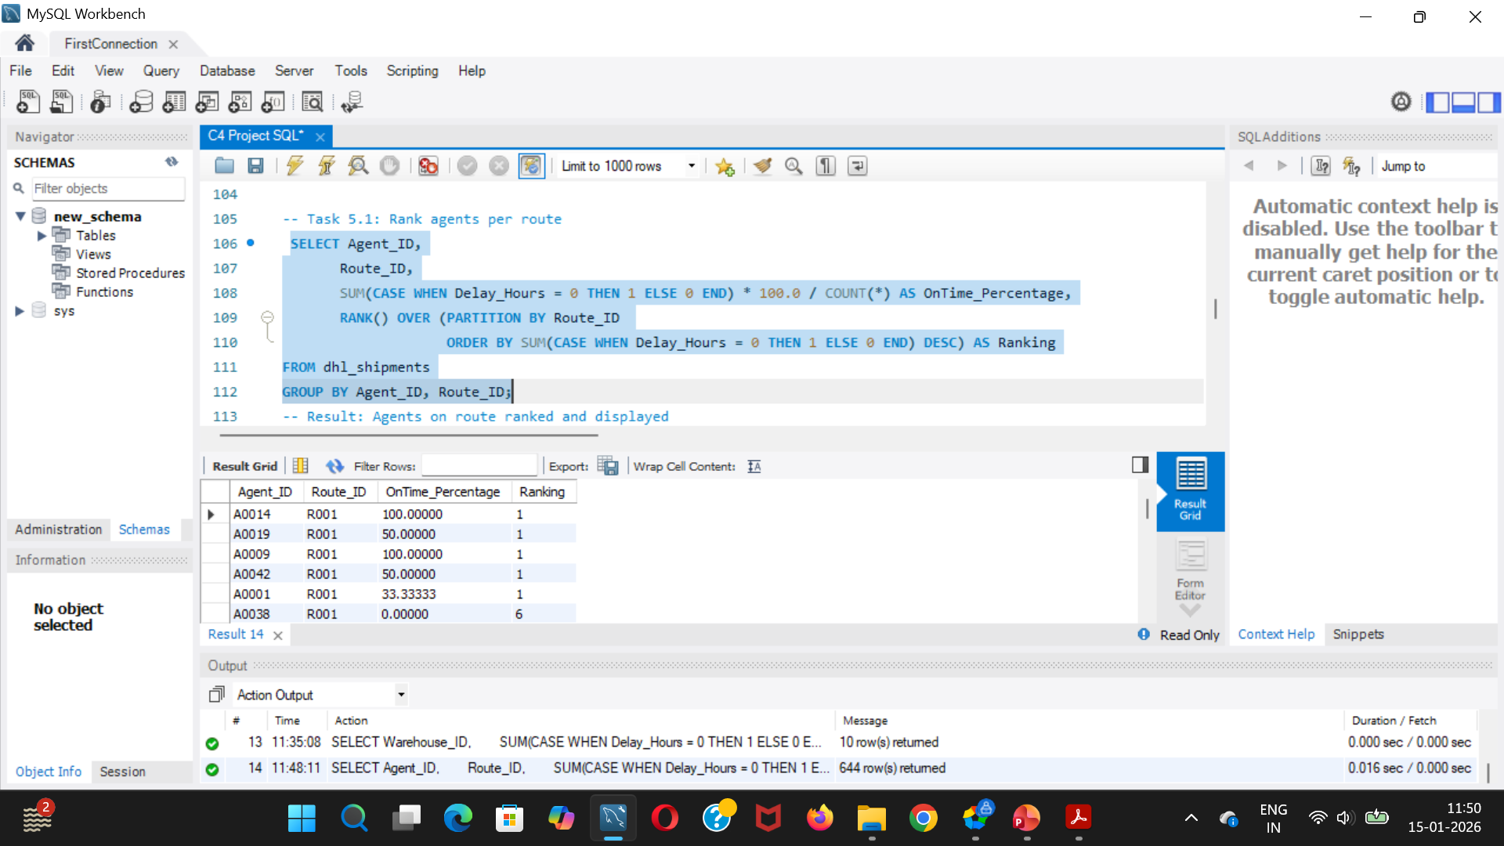
Task 5: Ranking of delivery agents by on-time delivery percentage

Slide 24
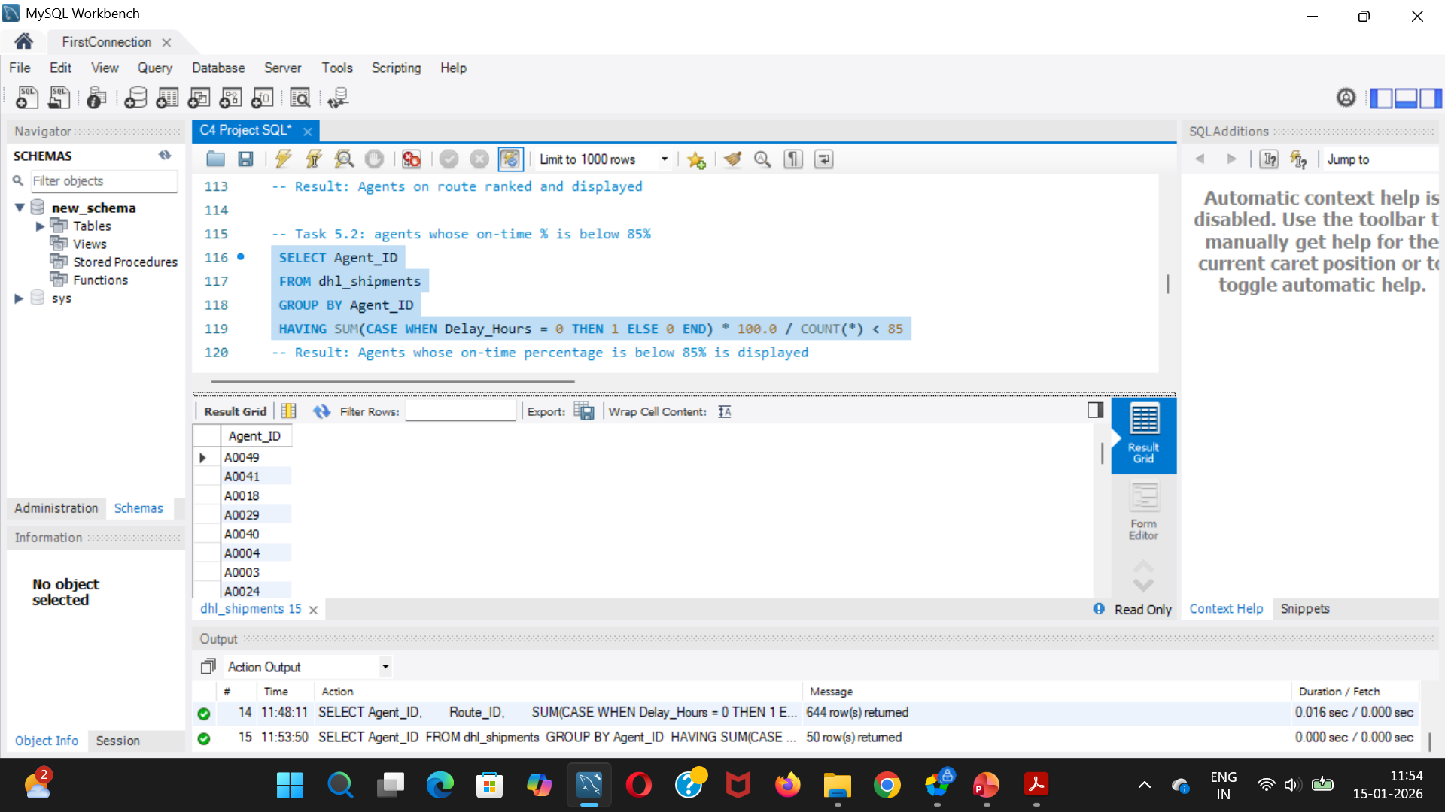
Task 5: Agents whose on-time % is below 85%

Slide 25
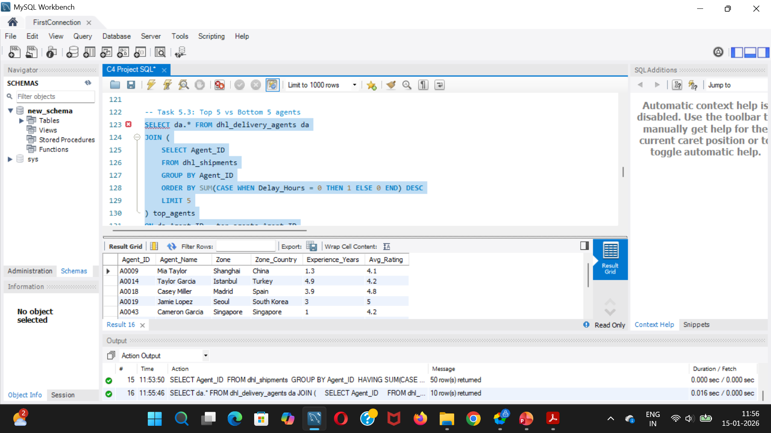
Task 5: Agents average rating and experience (in years) of the top 5 vs bottom 5

Slide 26
SHIPMENT TRACKING ANALYTICS (TASK 6)
Insights Extracted:
Latest shipment status for all deliveries
Routes with majority shipments In Transit or Returned
Most frequent delay reasons:
Customs clearance
Weather disruptions
Route congestion
Identified shipments delayed over 120 hours for investigation

Slide 27
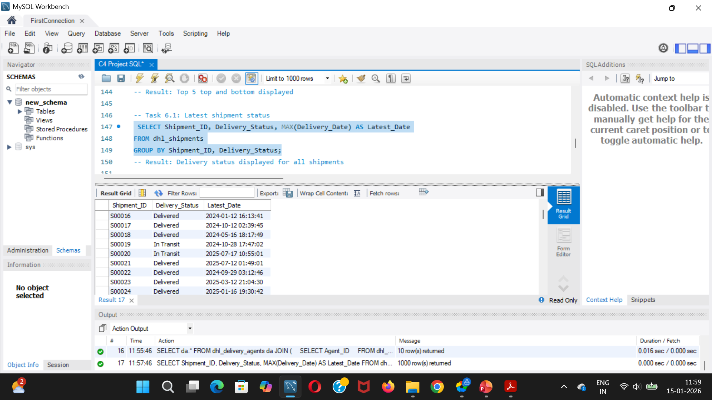
Task 6: Latest delivery status for each shipment

Slide 28
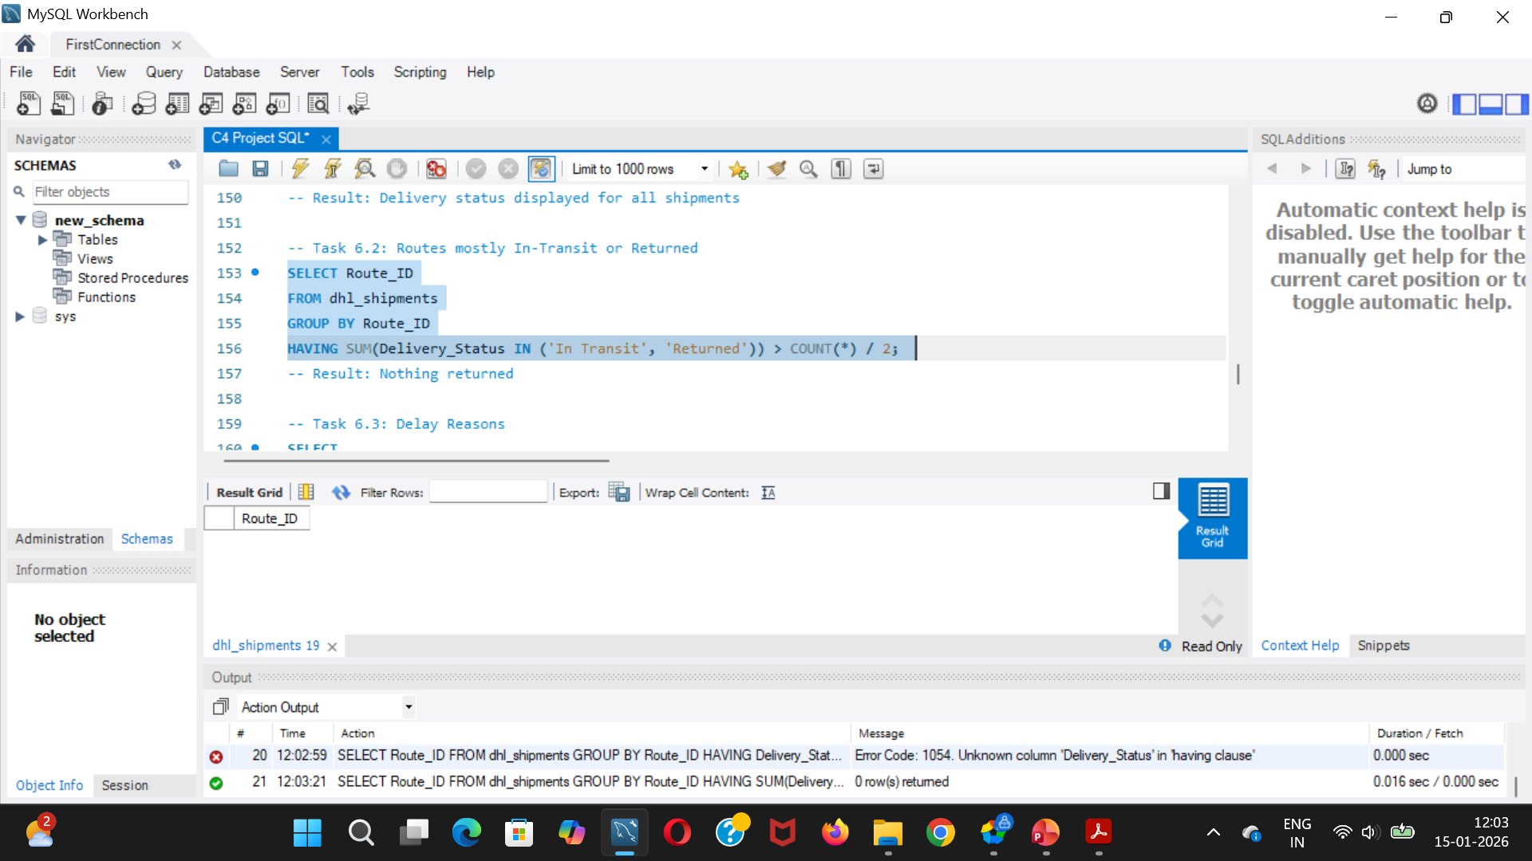
Task 6: Routes where shipments are still “In Transit” or “Returned”

Slide 29
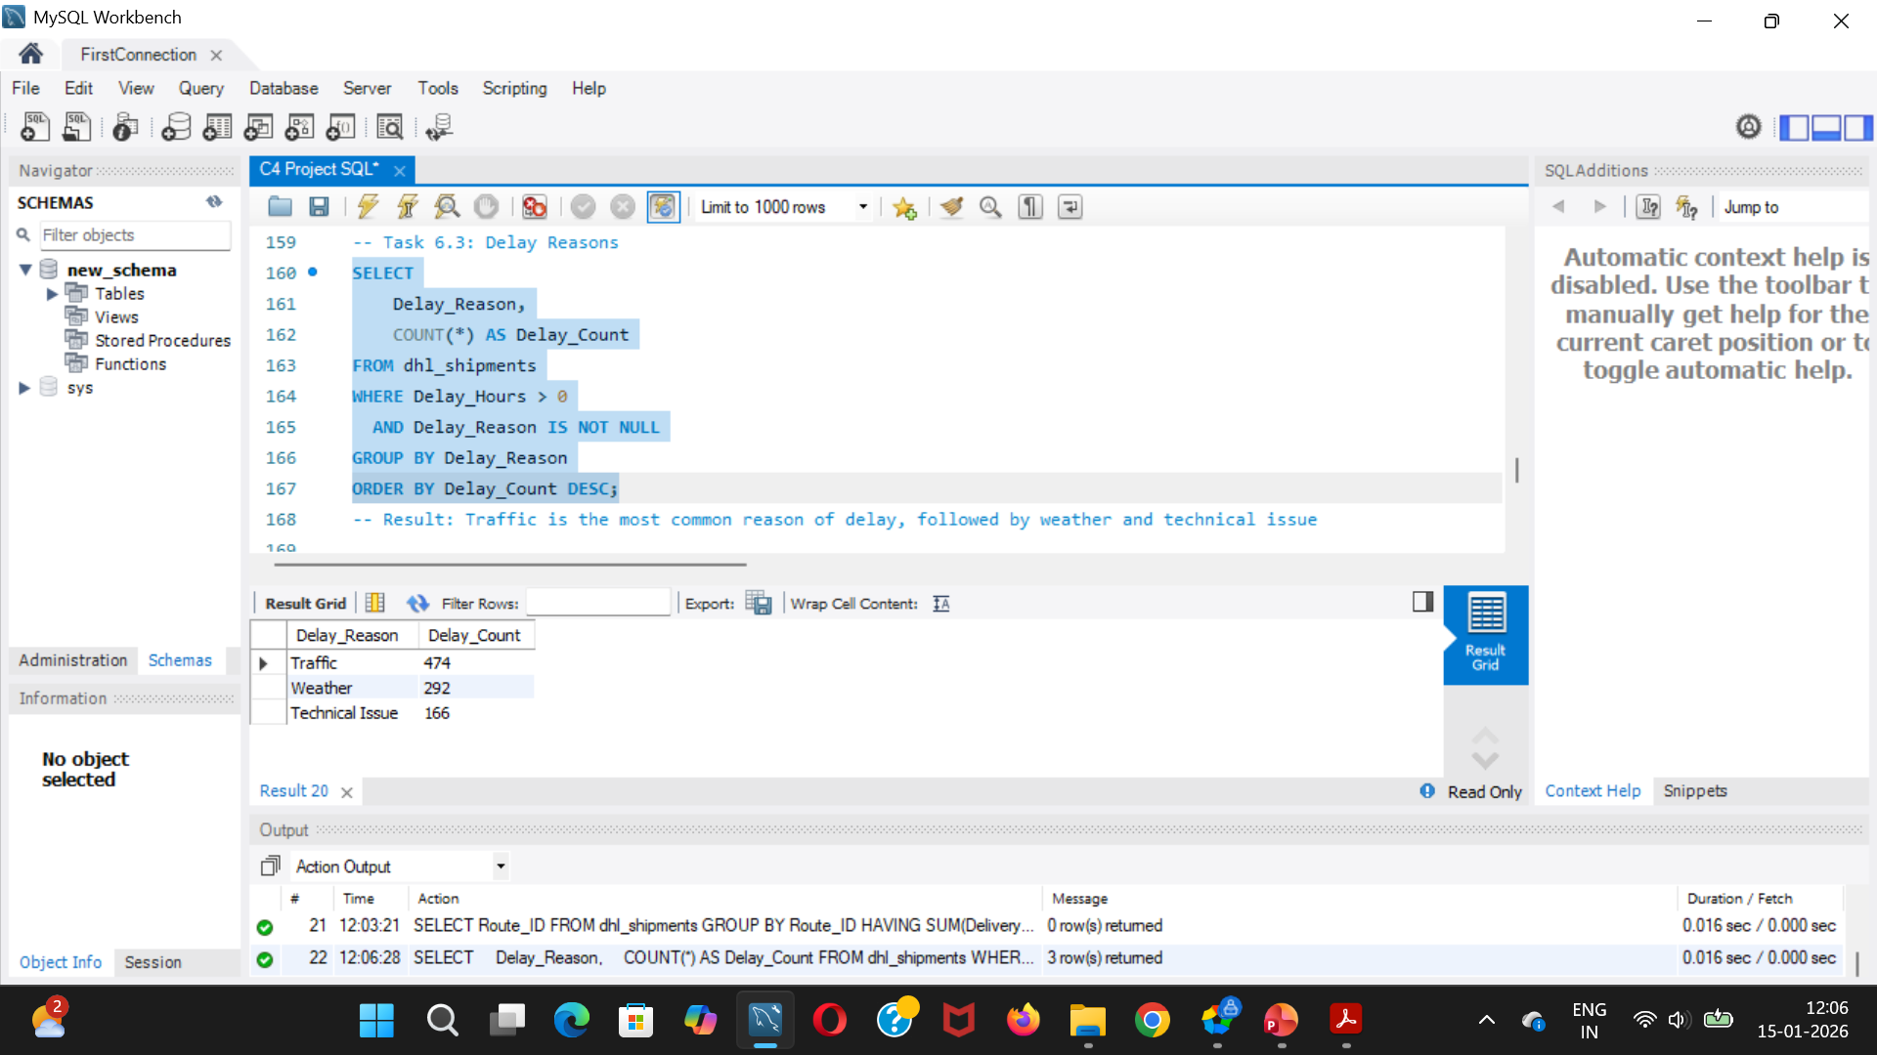
Task 6: Most frequent delay reasons

Slide 30
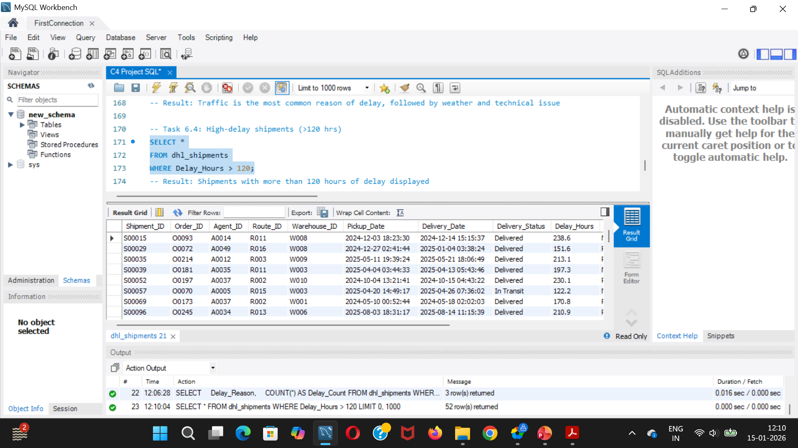
Task 6: Orders with exceptionally high delay (>120 hours)

Slide 31
KPI DASHBOARD (TASK 7)
Key Performance Indicators:
Average delivery delay per source country
On-time delivery percentage
Average delay per route
Warehouse utilization percentage
Purpose: Provide management-level visibility into logistics performance.

Slide 32
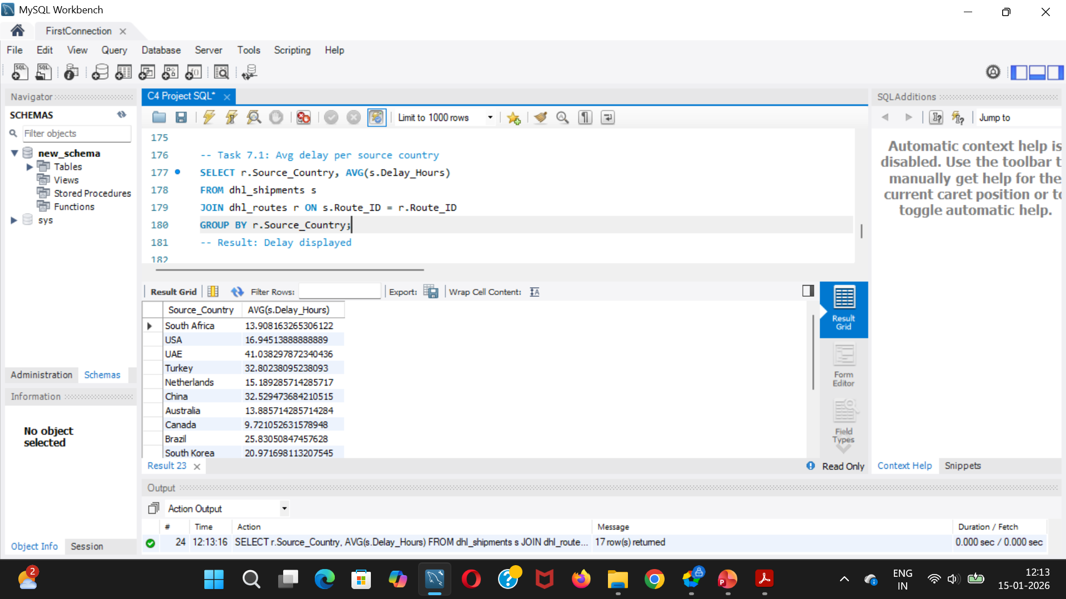
Task 7: Average Delivery Delay per Source_Country.

Slide 33
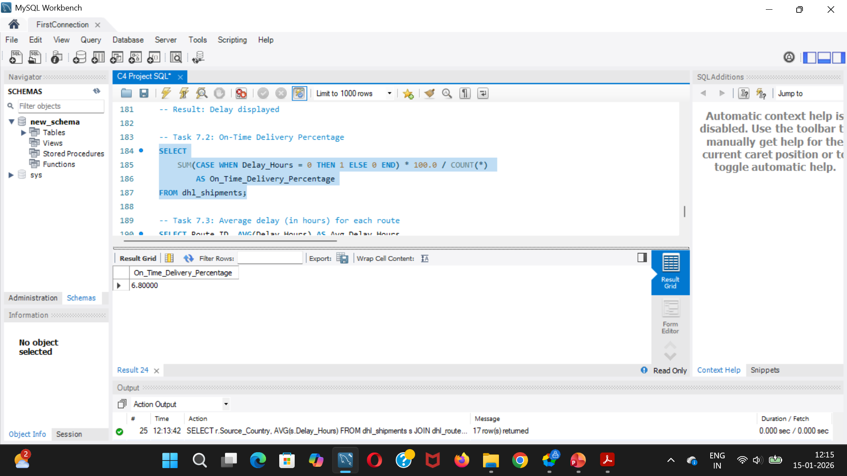
Task 7: On-Time Delivery % = (Total On-Time Deliveries / Total Deliveries) * 100

Slide 34
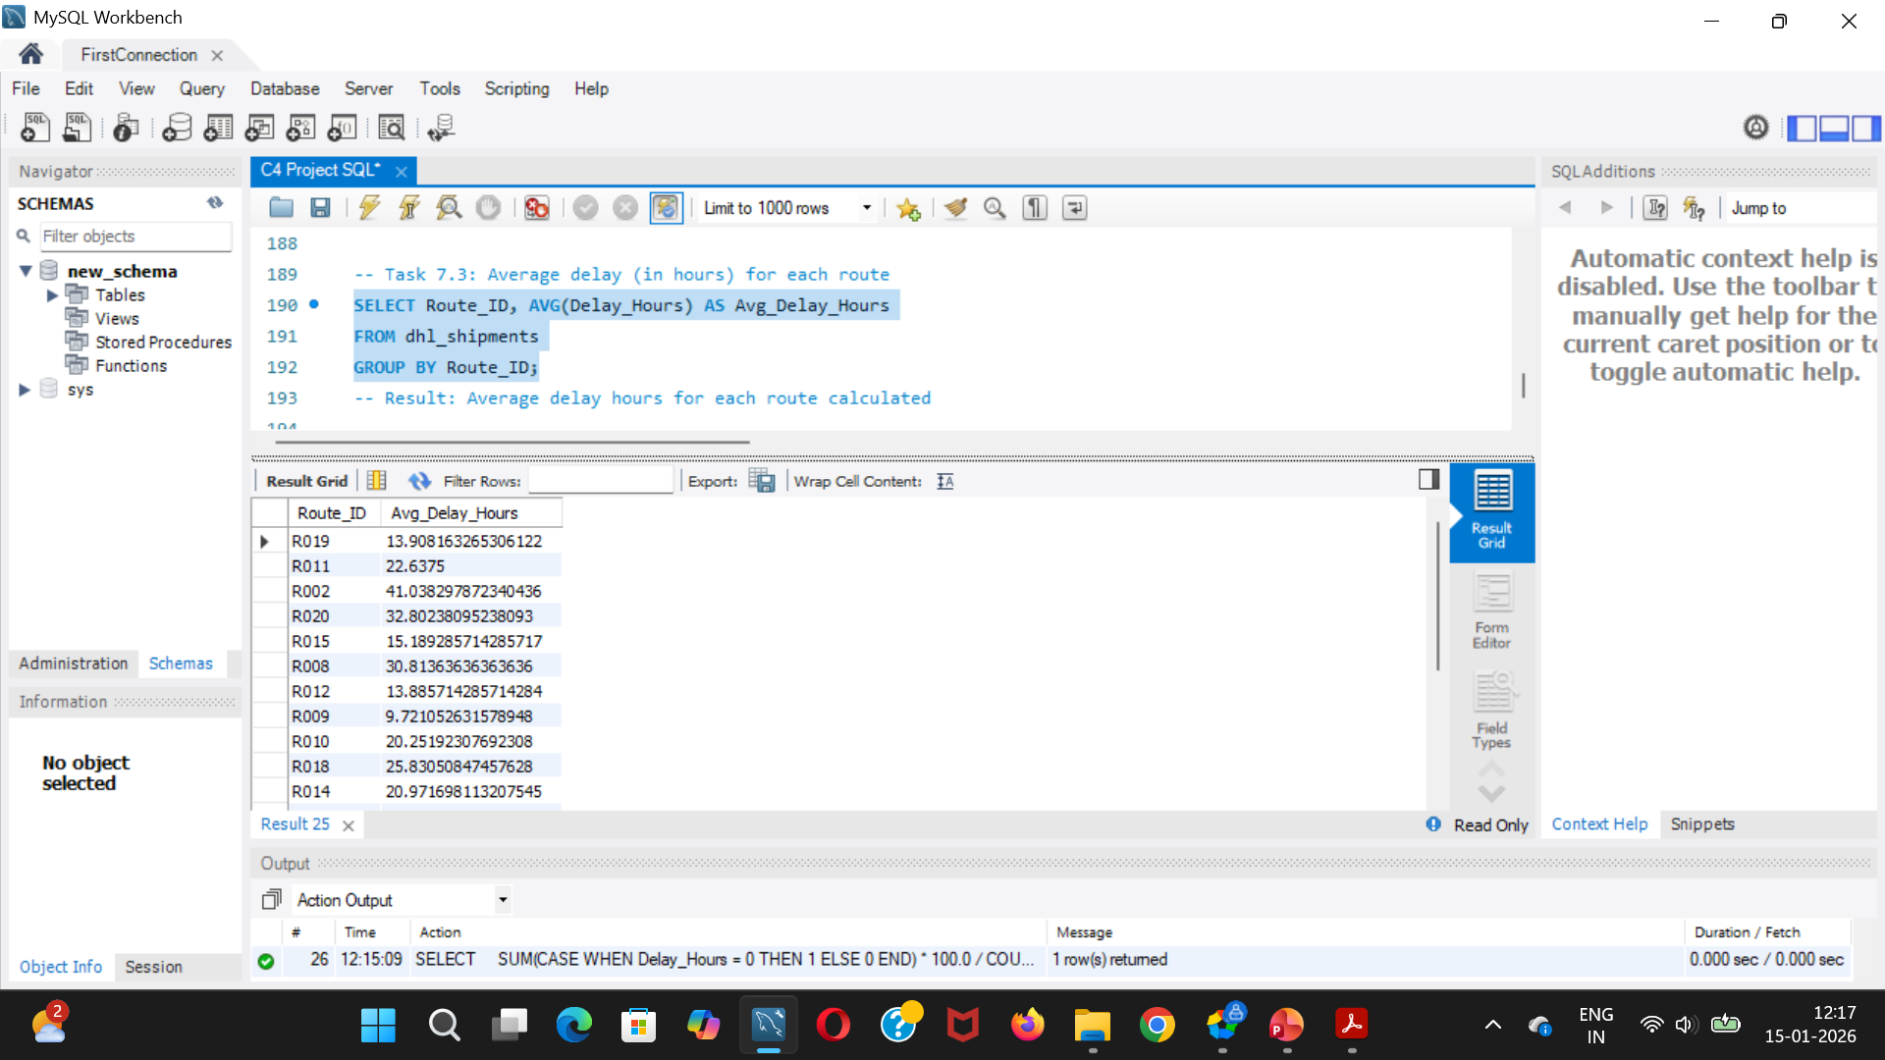
Task 7: Average Delay (in hours) per Route_ID

Slide 35
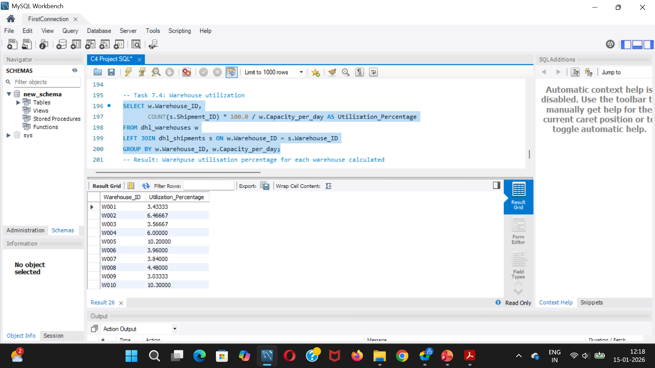
Task 7: Warehouse Utilization % = (Shipments_Handled / Capacity_per_day) * 100

Slide 36
KEY INSIGHTS
Route inefficiencies are a major contributor to delays
Customs and weather are the most frequent delay reasons
Overutilized warehouses show lower on-time delivery rates
Experienced delivery agents consistently outperform others

Slide 37
BUSINESS RECOMMENDATIONS
Optimize or redesign inefficient routes
Redistribute shipments across underutilized warehouses
Introduce targeted training programs for low-performing agents
Implement proactive monitoring for high-risk routes and hubs

Slide 38
CONCLUSION
SQL analytics enables deep visibility into logistics operations
Data-driven insights can significantly improve delivery reliability
The analytical framework can scale across DHL’s global network
Optimized logistics leads to better customer satisfaction and reduced costs

Slide 39
THANK YOU
THANK YOU

